Slide 1



The Career Confusion Crisis
Presented By:
SUJAY D (1VE23CA043)
SNEHA SHREE M (1SJ23CS160)
DISHA N B (1VE23CA016)
Team Name :SSD

Slide 2
Team Introduction & Contributions
1. Problem Statement – Disha
Research and compile data on student & early-career professional challenges.
Highlight limitations of traditional career counseling (cost, generic advice, outdated methods).
Explain employer challenges and talent-skill mismatch.
2. Proposed Solution – Disha
Describe the AI Career Path Finder platform and its features.
Explain profile input, career recommendation engine, skill gap analyzer, AI mentor chatbot, and career roadmap.
Emphasize value proposition: personalized, affordable, and up-to-date guidance.
3. Technical Overview ,implementation – Sujay D
Outline tech stack: Frontend (React/Flutter), Backend (Node.js/FastAPI), Database (Firebase/MongoDB), AI/ML (Scikit-learn/TensorFlow), NLP (OpenAI API).
Explain architecture flow: User → ML Model → Chatbot → Database → Frontend dashboard.
4. Output &Market & Business Analysis – Sneha
Target users, market size, feasibility, and scalability.
:Focus on target users & feasibility.
Market size & scalability strategy.
5. Impact – Sneha
Sneha: Technical impact (AI-driven recommendations, bridging education-employment gap).
:Social & business impact (accessibility, partnerships, SaaS model, long-term revenue).

Slide 3

Problem Statement
The problem statement is about like 70%+ of students and early-career professionals face career confusion. Traditional career counseling is: • Expensive 💰 • Generic (not personalized) 📝 • Outdated (not aligned with current industry needs) ⏳ - Employers struggle to find candidates with the right skills, leading to: • Talent-skill mismatch • Wasted resources in hiring/training - Result → Career confusion + skills gap + hiring inefficiency.

Slide 4

Proposed solution
A personalized career guidance system powered by AI/ML.
Profile Input: User enters skills, interests, or uploads resume.
Career Recommendation Engine: Suggests top career paths with demand insights.
Skill Gap Analyzer: Identifies missing skills & recommends learning resources.
AI Mentor Chatbot: Provides career advice, course suggestions, and project ideas
Career Roadmap: Step-by-step guide (skills → certifications → jobs).

Slide 5
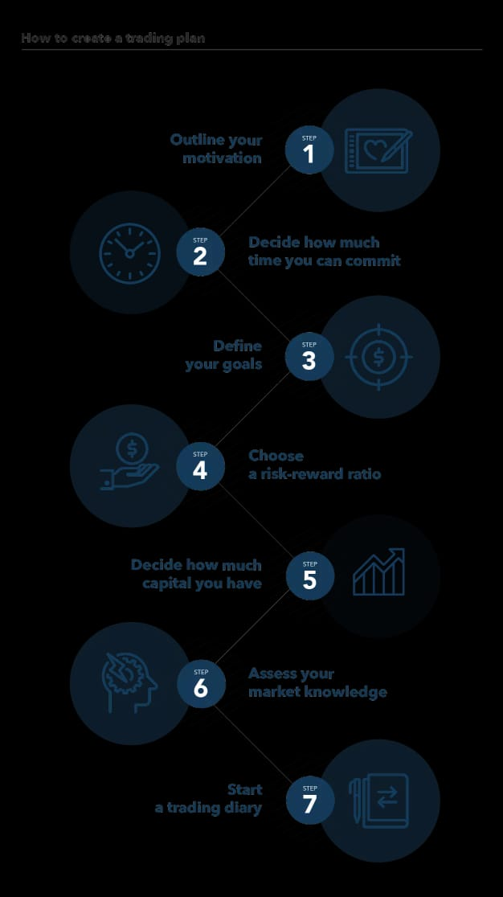
. Technical Overview
Built using React/Flutter (frontend) and Node. backend) for a seamless, cross-platform user experience.
AI-powered recommendation engine (Scikit-learn/TensorFlow) suggests ideal careers and analyzes skill gaps.
NLP-driven chatbot (OpenAI API) provides personalized career guidance and learning roadmaps.
Firebase/MongoDB database securely stores user profiles, progress, and analytics data
Integrated architecture connects user inputs → ML model → chatbot → database → interactive dashboard.

Slide 6
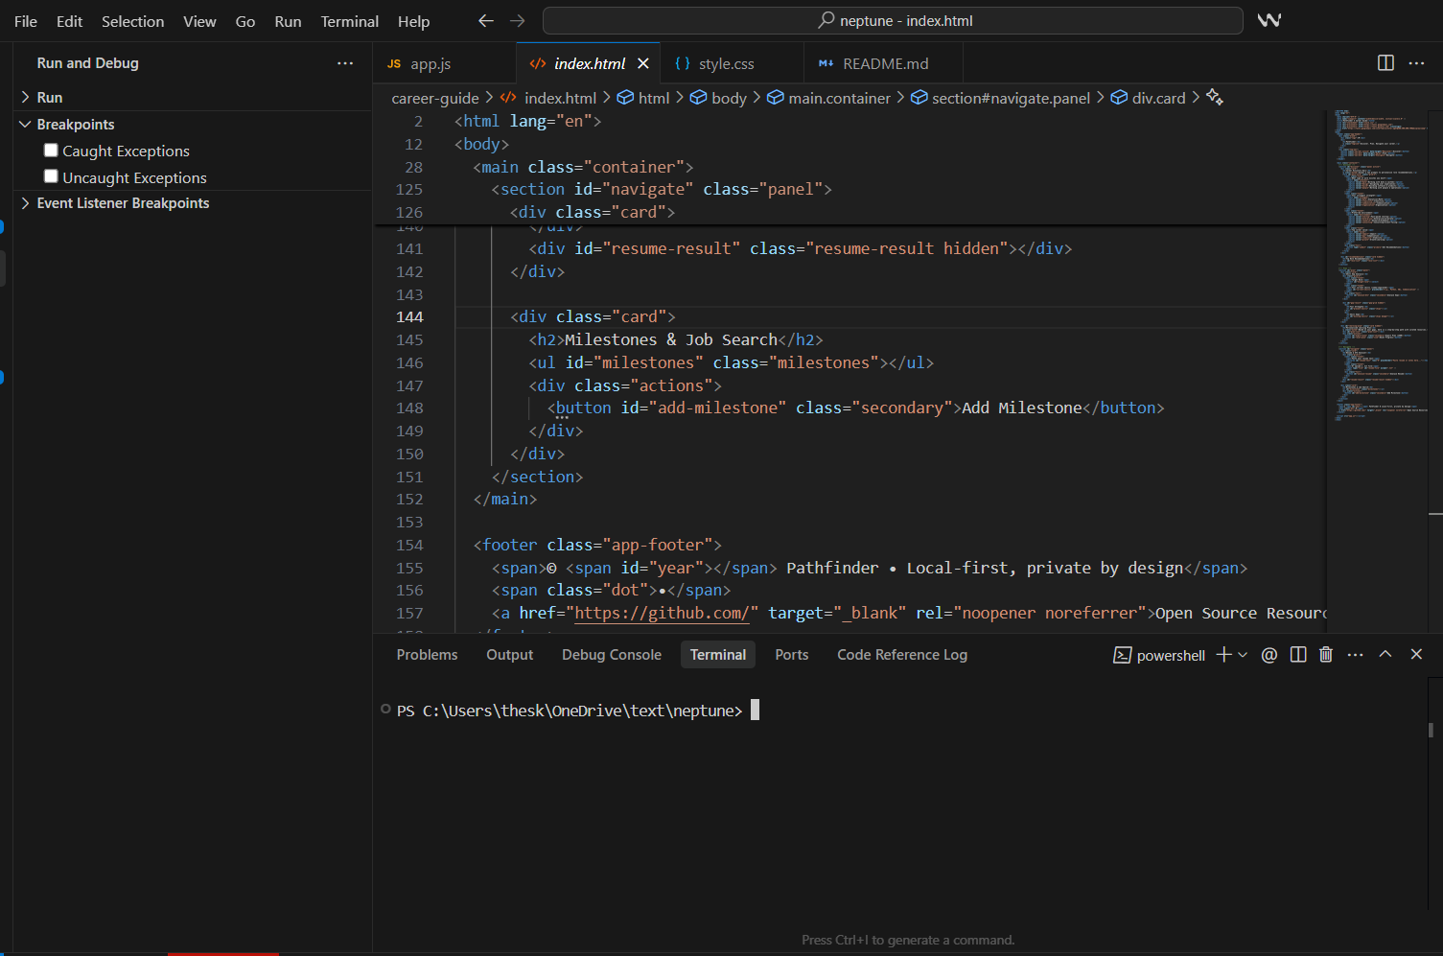
Implementation

Slide 7
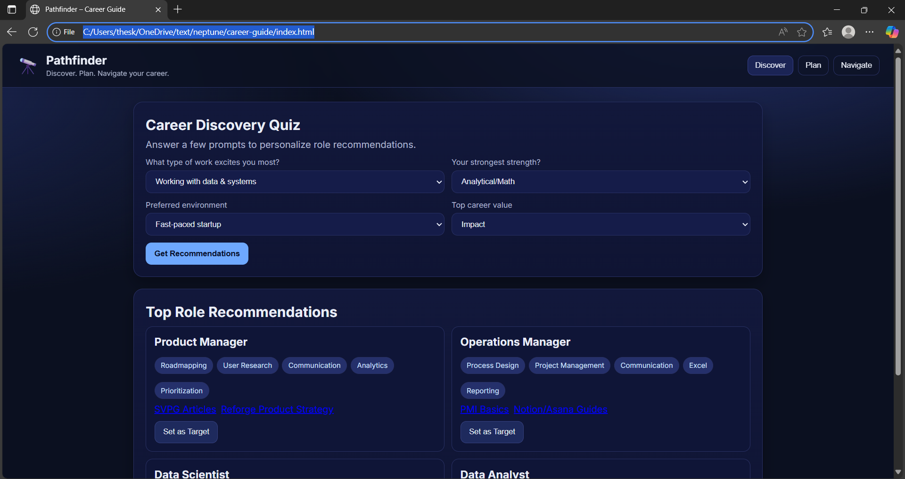
Output/website

Slide 8
Market & Business Analysis
Target Users: Students, early-career professionals, and career counselors form the core user base.
Market Opportunity: Global career counseling market valued at ~$2.7B with rapid EdTech growth (> $300B by 2027).
Feasibility: Easy to develop and deploy as a low-cost web or mobile app using available datasets and APIs.
Integration Potential: Can connect with platforms like LinkedIn, Coursera, and job portals for enhanced functionality.
Scalability: Expand from individual users to institutions and enterprises with premium features like analytics, mentorship, and resume tools.

Slide 9
Impact – Social, Technical, or Business Value
Social Impact: Makes career counseling accessible, affordable, and inclusive for all learners.
Educational Benefit: Empowers students to make informed career choices and reduce skill mismatches.
Technical Impact: Leverages AI for personalized recommendations and real-time education–employment insights.
Business Potential: Enables partnerships with EdTech and job platforms for integrated career solutions.
Scalability & Sustainability: Operates as a SaaS model for institutions, ensuring long-term revenue and social impact.

Slide 10
Git Hub Link & Youtube LinkHub Link
Git Hub Link
:https://github.com/U-disha/career-guide
Youtube Link :https://youtu.be/6CSS6_JEgGs?si=A8awNWHmV29PaeZO

Slide 11

Thank You

